Slide 1

Short-circuit Evaluation

Slide 2
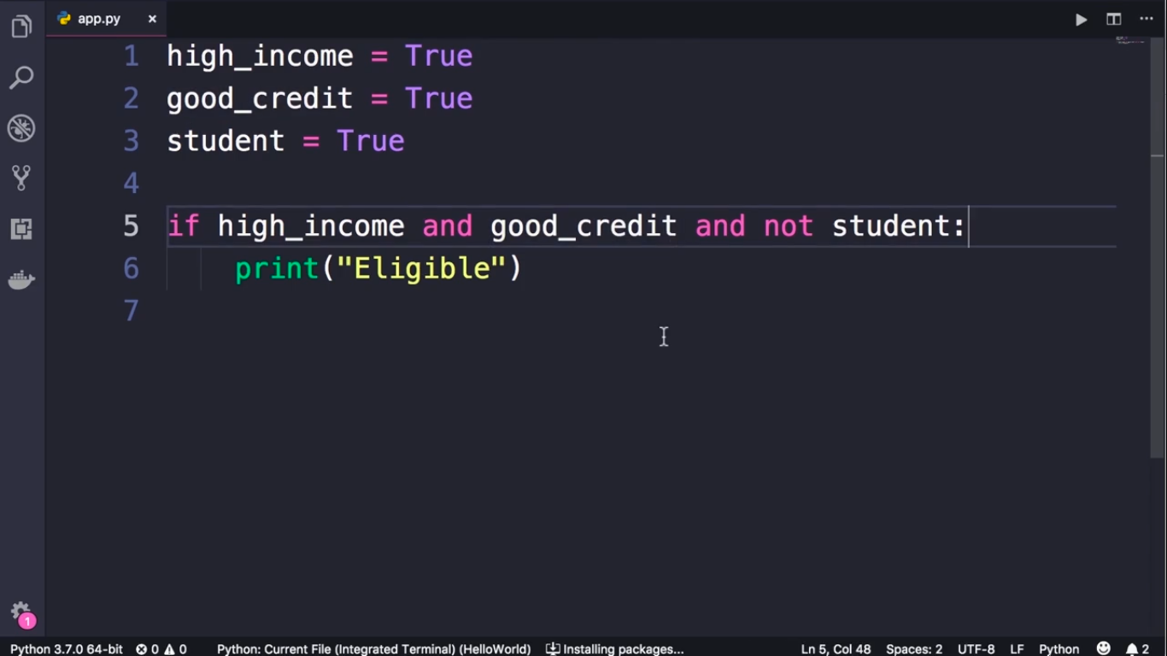

Slide 3
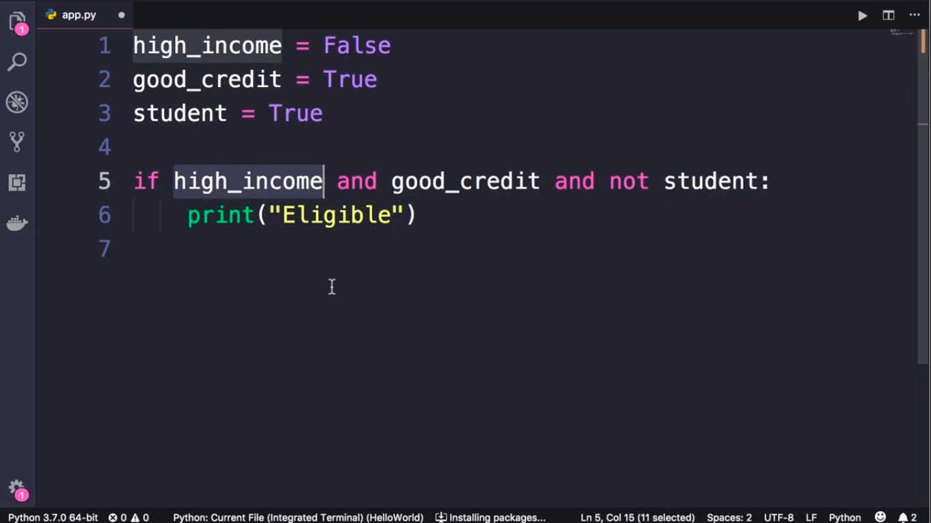

Slide 4
